Slide 1
Twitter Sentiment Analysis
1131122522 Kesavan
1131121058 Bavitaran

Slide 2
Introduction
Sentiment Analysis is a program that analyse the sentence which is positive, neutral or negative. The data collect from twitter analysed and display the data with sentiment analysis.

Slide 3
Sentiment Analysis on Twitter Data

Slide 4
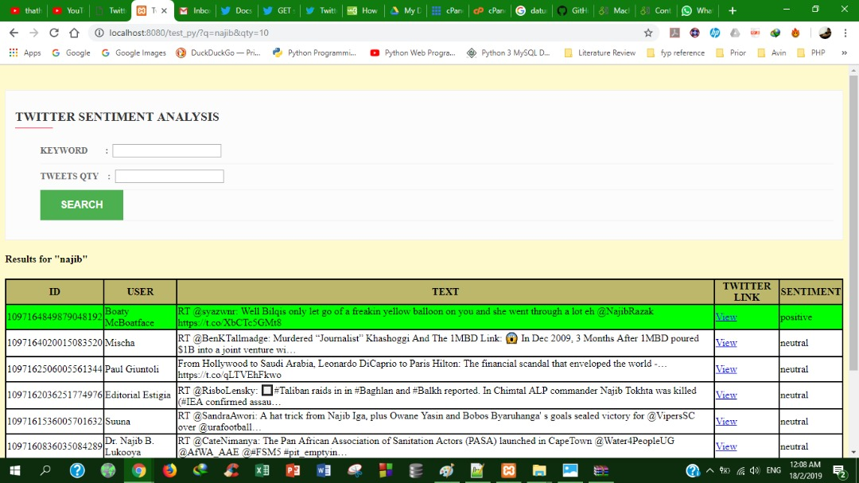

Slide 5
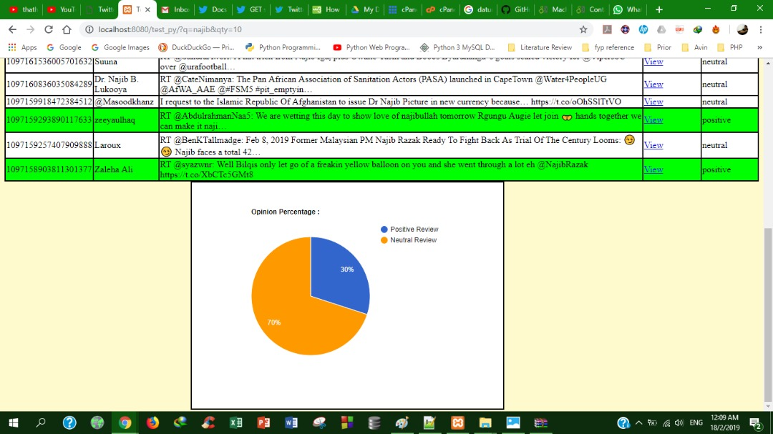

Slide 6
Conclusion
The analysis of Twitter data been done in different points of view to mine the opinion or sentiment. This program defined the concept of sentiment analysis and opinion mining with respect to various levels of sentiment analysis.

Slide 7
Thank You.

